Slide 1
Prioritizing Impact, Maximizing Efficiency
Focusing our efforts

Slide 2
Steps
Step 1: ID College/Unit Organizational Priorities
Step 2: ID Team Strategic Priorities
Step 3: ID Buckets of Work
Step 4: ID Tasks Within Buckets
Step 5: Outline Next Steps in Decision Making Process

Slide 3
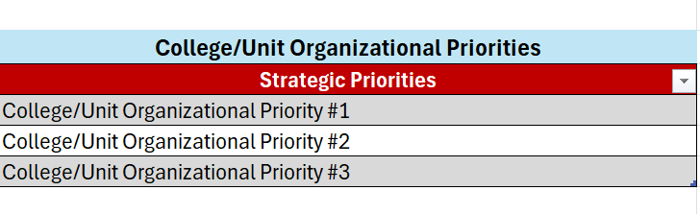
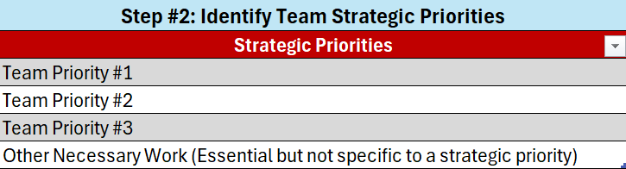
Step 1: ID College/Unit Organizational Priorities
Step 2: ID Team Organizational Priorities

Slide 4
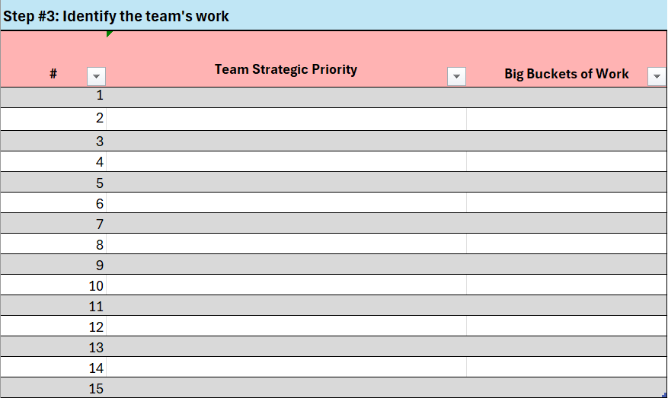
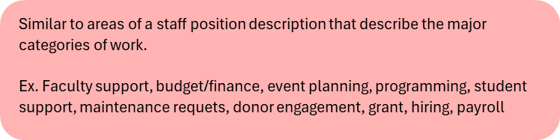
Step 3: ID Buckets of Work

Slide 5
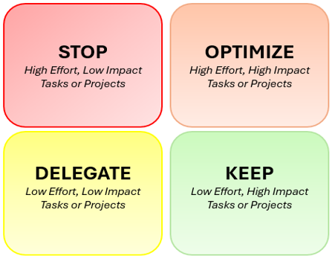
Step 4: ID Tasks Within Buckets
Once you’re in the workbook, you will be using Impact vs. Effort to locate tasks within one of these 4 quadrants to help you prioritize moving forward!
You will find this model and definitions on the far right of the Task Identification tab!
Let’s take a look at the workbook to see the prioritization tool in action!

Slide 6
Step 5: Determine Leads/Decision Makers
You’ve done a lot of great work to this point! Now we need to identify who the correct leads and decision makers are in order to move forward!
Let’s go back to our workbook to look at how we fill out this step

Slide 7
Ways to Engage with this Tool
  Communicate with your HR Lead and let them know you will start using this tool
    Each College/Unit may have a slightly different approach! Your HR Director may be able to provide useful insight.
  Engage ODE (Organizational Development & Effectiveness) for a 1.5-2hr learning lab where we will work through the tool with your group
    Contact Ari Mack (ajm525@cornell.edu), Kathy Burkgren (klb18@cornell.edu), Tanya Grove (tl40@cornell.edu), Steve Jackson (sbj1@cornell.edu)
  Identify opportunities for optimization and process improvement. Strategies for this include…
    Work Redesign – Consider use of AI, Lean process improvement/streamlining
    Course Design - Lean Mindset

